Slide 1
Employee Data Analysis using Excel
STUDENT NAME: Swetha.S
REGISTER NO. :312204253
DEPARTMENT: B.COM (Accounting and finance)
COLLEGE. Annai violet art's and Science College

Slide 2
PROJECT TITLE
Employee Performance Analysis using Excel.
Visualising Employee Attendance
Trends with Excel Charts

Slide 3


AGENDA
Problem Statement
Project Overview
End Users
Our Solution and Proposition
Dataset Description
Modelling Approach
Results and Discussion
Conclusion
3/21/2024 Annual Review

Slide 4

PROBLEM STATEMENT
Data Modelling, DAX, Calculated measures and more. In this project, an analysis was conducted to showcase the employee attendance trends, work preference patterns, such as working from home, and the frequency of sick leaves taken. The objective was to provide insights for managers to facilitate meeting planning and allocation of office space in accordance with the majority of employee presence in a given week etc.

Slide 5

WHO ARE THE END USERS?
use charts and graphs to filter data and understand variables
Create a new spreadsheet Set up column headers Highlight weekends and holidays Implement data validation Lock input cells Calculate absences and presents Share the spreadsheet Create monthly attendance summaries

Slide 6

OUR SOLUTION AND ITS VALUE PROPOSITION
Our Excel-based employee performance analysis tool offers a customizable system for tracking and evaluating employee metrics with automated dashboards for real-time insights. This cost-effective solution improves decision-making and fosters employee engagement through regular feedback and progress tracking. By streamlining performance management, organizations can enhance productivity and achieve better outcomes.

Slide 7
Dataset Description
The dataset for visualizing employee attendance trends typically includes columns for employee IDs, names, dates, and attendance status (e.g., present, absent, or late). Each row represents an individual attendance record, allowing for daily tracking of employee presence. This structured format enables effective analysis of attendance patterns over specified time periods.

Slide 8

THE "WOW" IN OUR SOLUTION
The "wow" factor in our Excel-based employee performance analysis solution lies in its intuitive dashboards that transform complex data into clear visuals, making insights easily accessible. It empowers managers with customizable metrics to tailor performance tracking to their specific needs. Additionally, the automation features save time, allowing HR teams to focus on strategic initiatives rather than manual data entry.
3/21/2024 Annual Review
8

Slide 9
MODELLING
To visualize employee attendance trends in Excel, first organize your data with columns for dates, employee names, and attendance status. Create a Pivot Table to summarize the data by relevant categories, then insert a line or bar chart to illustrate trends over time. This visual representation helps identify patterns in attendance, enabling better HR decision-making.
9

Slide 10
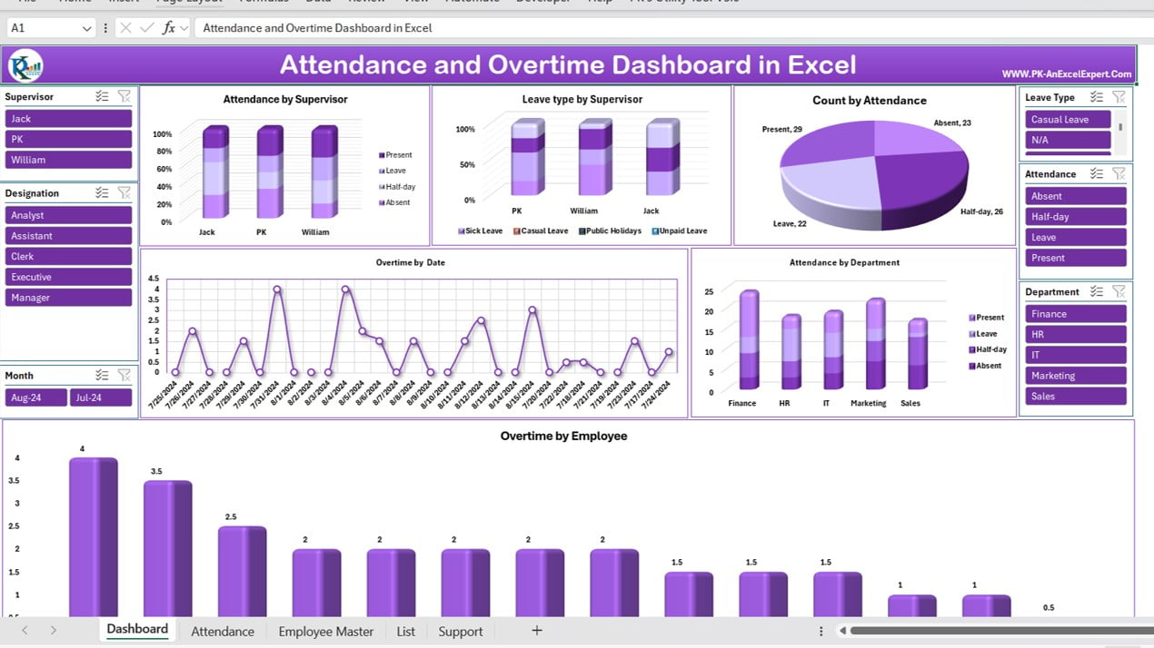
RESULTS
10

Slide 11
conclusion
, our Excel-based employee performance analysis tool streamlines the evaluation process, making it accessible and effective for organizations of all sizes. By providing real-time insights and customizable metrics, it enhances both employee engagement and productivity. Ultimately, this solution empowers managers to make informed decisions that drive overall business success.

